Slide 1

ECE 2700
Digital Circuits
Multiplier
Signed Numbers
Copyright © 2010 Frank Vahid
Instructors of courses requiring Vahid's Digital Design textbook (published by John Wiley and Sons) have permission to modify and use these slides for customary course-related activities, subject to keeping this copyright notice in place and unmodified. These slides may be posted as unanimated pdf versions on publicly-accessible course websites.. PowerPoint source (or pdf with animations) may not be posted to publicly-accessible websites, but may be posted for students on internal protected sites or distributed directly to students by other electronic means. Instructors may make printouts of the slides available to students for a reasonable photocopying charge, without incurring royalties. Any other use requires explicit permission. Instructors may obtain PowerPoint source or obtain special use permissions from Wiley – see http://www.ddvahid.com for information.

Slide 2
Today’s Objectives
To understand the design of a simple multiplier
To become familiar with signed numbers

Slide 3
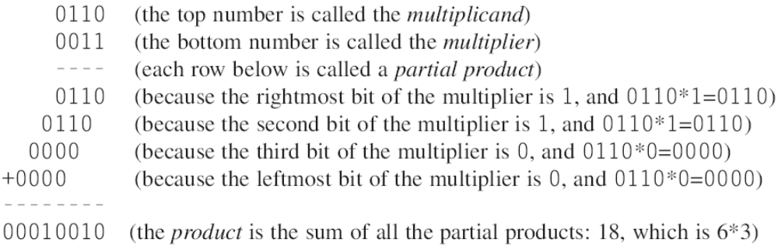
Multiplier
Can build multiplier that mimics multiplication by hand
  Note that multiplying multiplicand by 1 is same as ANDing with 1

Slide 4
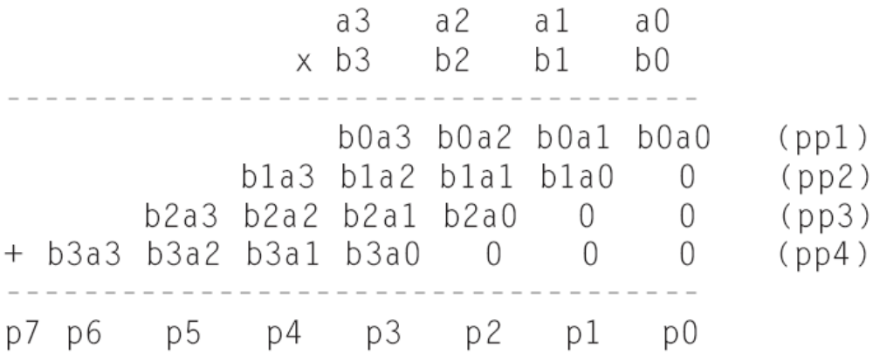
Multiplier Design Idea
Generalized representation of multiplication by hand

Slide 5
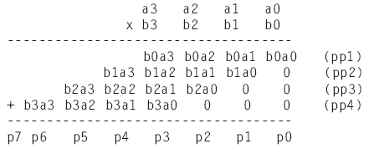
Multiplier – Array Style
Array of AND gates and
a number of adders
a3
a2
a1
a0
b0
pp1
b1
pp2
0
0
b2
+ (5-bit)
pp3
0
0
b3
A
B
+ (6-bit)
*
pp4
P
0
0
0
+ (7-bit)
Block symbol
p7..p0

Slide 6
Multiplication By A Power of 2
Special cases
  Why?
Multiplying a number by 2 is equivalent to…
  Shifting left 1 bit
How about multiplying a number by 8?
  Shifting left 3 bits
How about division?
  Shift right
Why/how does this work?

Slide 7
General Number Representation
N-bit unsigned numbers
  Range: [0, 2^{N-}1]
Signed numbers
Bit N-1
Bit 1
Bit 0
MSB
LSB
Magnitude
Bit N-1
Bit N-2
Bit 1
Bit 0
sign
MSB
LSB
0 if number is positive
1 if number is negative
Magnitude

Slide 8
Signed Number Representations
Three popular ways
  Signed-magnitude
  1’s complement
  2’s complement

Slide 9
Signed-Magnitude
Mimic our number system
  Positive 5: 5
  Negative 5: -5
So in binary
  Positive 5: 0101
  Negative 5: 1101
Number | Signed-Magnitude
+3 | 0 11
+2 | 0 10
+1 | 0 01
+0 | 0 00
-0 | 1 00
-1 | 1 01
-2 | 1 10
-3 | 1 11

Slide 10
Question (AP)
How is -8 represented using a 6-bit signed-magnitude representation?
  001000
  101000
  111000
  None of the above
  ☹

Slide 11


Adding Two Signed Numbers
(+5)
0 1 0 1
(-5)
1 1 0 1
+
+
(+2)
0 0 1 0
(-2)
1 0 1 0
0 1 1 1
1 0 1 1 1
(+5)
0 1 0 1
(-5)
1 1 0 1
+
+
(-2)
1 0 1 0
(+2)
0 0 1 0
1 1 1 1
1 1 1 1
For the result to be correct, we need to subtract the smaller number from the larger one → Comparison logic needed

Slide 12
Problems With Sign-and-Magnitude
Addition and subtraction require different logic circuits
Overflow is difficult to detect
“Zero” has two representations
  + 0_{ten} = 00000000_{two}
  - 0_{ten} = 10000000_{two}
Not used in modern digital systems

Slide 13
1’s Complement
Simply complementing all the bits to get a negative number
  Positive 2: 0010
  Negative 2: 1101
In decimal
  30 is the complement
  of 70
    Because 30 + 70 = 10²
In binary
  1101 is the complement
  of 0010
    0010 + 1101 = 1111
    1111 = 2⁴
Decimal magnitude | Binary number
 | Positive | Negative
0 | 0000 | 1111
1 | 0001 | 1110
2 | 0010 | 1101
3 | 0011 | 1100
4 | 0100 | 1011
5 | 0101 | 1010
6 | 0110 | 1001
7 | 0111 | 1000

Slide 14
Question (AP)
If we use 1’s complement to represent signed number, what is the value of 1111 0111?
  -8
  8
  -247
  247
  ☹

Slide 15
Question (AP)
If we use 1’s complement to represent signed number, what is the value of 0000 0111?
  -7
  7
  -248
  248
  ☹

Slide 16

Adding Two Signed Numbers
(+5)
0 1 0 1
(-5)
1 0 1 0
+
+
(+2)
0 0 1 0
(-2)
1 1 0 1
0 1 1 1
1 0 1 1 1
1
1 0 0 0
(+5)
0 1 0 1
(-5)
1 0 1 0
+
+
(-2)
1 1 0 1
(+2)
0 0 1 0
1 0 0 1 0
1 1 0 0
1
0 0 1 1

Slide 17
Problems With One’s Complement
Addition is still complicated
0 ≠ -0
Can we find a better signed number representation?

Slide 18
2’s Complement
Invert all bits and
add 1
  Positive 2: 0010
  Negative 2: 1110
Range is [-2^{N-1}, 2^{N-1}-1]
  Signed 8-bit
    -128 to 127
Decimal magnitude | Binary number
 | Positive | Negative
0 | 0000
1 | 0001 | 1111
2 | 0010 | 1110
3 | 0011 | 1101
4 | 0100 | 1100
5 | 0101 | 1011
6 | 0110 | 1010
7 | 0111 | 1001
8 |  | 1000

Slide 19
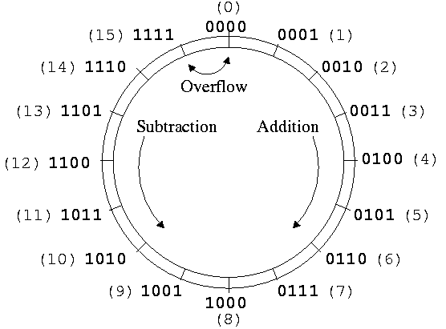
Visual Representation of Unsigned Num.

Slide 20
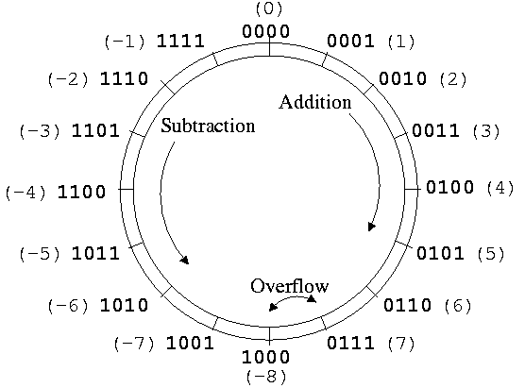
Visual Representation of 2’s Complement

Slide 21
Question (AP)
What’s the two’s complement of 0101?
  1010
  1011
  0110
  0101
  ☹

Slide 22
Determining Magnitude of Negative Num.
4-bit: subtract right 3 bits from 8
  1110: -(8 – 6) = -2
Or just take two’s complement again
  1110: -(0001+1) = -0010 = -2
In general, to determine the magnitude of a 2’s complement number
  If starts with 0, determine magnitude directly
  If starts with 1, invert all the bits, add 1, then determine magnitude

Slide 23
Question (AP)
Express -2 in an 8-bit format
  1000 0010
  1000 1110
  0000 1110
  1111 1110
  ☹

Slide 24
Three Representations
Sign-magnitude
000 = +0
001 = +1
010 = +2
011 = +3
100 = - 0
101 = - 1
110 = - 2
111 = - 3
1’s complement
000 = +0
001 = +1
010 = +2
011 = +3
100 = - 3
101 = - 2
110 = - 1
111 = - 0
2’s complement
000 = +0, -0
001 = +1
010 = +2
011 = +3
100 = - 4
101 = - 3
110 = - 2
111 = - 1
(Preferred)

Slide 25
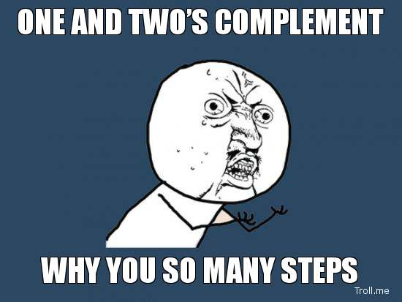
Why Oh Why?

Slide 26
Adding Two Numbers
(+5)
0 1 0 1
(-5)
1 0 1 1
+
+
(+2)
0 0 1 0
(-2)
1 1 1 0
0 1 1 1
1 1 0 0 1
(+5)
0 1 0 1
(-5)
1 0 1 1
+
+
(-2)
1 1 1 0
(+2)
0 0 1 0
1 0 0 1 1
1 1 0 1
Rule: Always ignore the carry out

Slide 27
Question (AP)
What’s the two’s complement of 0000?
  0000
  1111
  10000
  0001
  ☹

Slide 28
Why Does It Work?
Let’s consider numbers in base 10 since they are more natural
Ten’s complement shown
on the right side
  Complement is the number
  that when added results in 10
  Instead of subtracting a number,
  adding its complement results in
  answer exactly 10 too much
  So just drop the 1
    Results in subtracting using addition only
1
9
2
8
3
7
4
6
5
5
6
4
7
3
8
2
9
1
8–1=7
8+9=17
7

Slide 29
Today’s Objectives
To understand the design of a simple multiplier
To become familiar with signed numbers

Slide 30
Question
Consider a binary number x represented in two’s complement. If x = 101110, what is its value in decimal?

